Slide 1
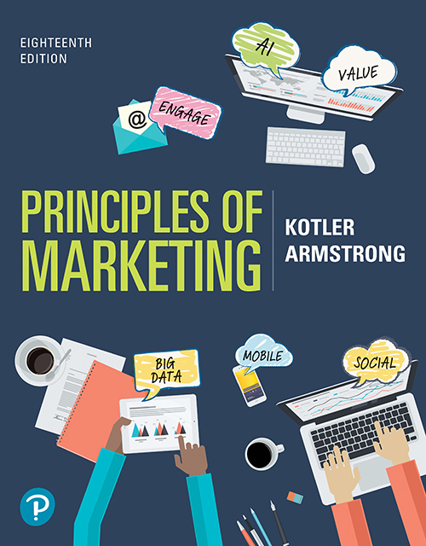
Principles of Marketing
Eighteenth Edition
Chapter 12
Marketing Channels: Delivering Customer Value
Copyright © 2021, 2018, 2016 Pearson Education, Inc.
Notes:
If this PowerPoint presentation contains mathematical equations, you may need to check that your computer has the following installed:
1) Math Type Plugin
2) Math Player (free versions available)
3) NVDA Reader (free versions available)

Slide 2

NETFLIX: Finding the Future by Abandoning the Past
Time and again, Netflix has innovated its way to the top in the distribution of video entertainment. But to stay atop its boiling, roiling industry, Netflix must keep the distribution innovation pedal to the metal.
Netflix’s innovative distribution strategy: From DVDs by mail to Watch Instantly to streaming on almost any device and creating original content, Netflix has led the howling pack by doing what it does best—revolutionize distribution. What’s next?
Notes:
To stay ahead, Netflix must lead change and “find its future by abandoning its past.”

Slide 3
Learning Objectives
12.1 Explain why companies use marketing channels and discuss the functions these channels perform.
12.2 Discuss how channel members interact and how they organize to perform the work of the channel.
12.3 Identify the major channel alternatives open to a company.
12.4 Explain how companies select, motivate, and evaluate channel members.
12.5 Discuss the nature and importance of marketing logistics and integrated supply chain management.

Slide 4
Learning Objective 1
Explain why companies use marketing channels and discuss the functions these channels perform.
Notes:
Discussion Question
Describe how marketing channel members add value in the channel of distribution between manufacturers and consumers.
Learning Objective 1 Summary
In creating customer value, a company can’t go it alone. It must work within an entire network of partners—a value delivery network—to accomplish this task. Individual companies and brands don’t compete, their entire value delivery networks do. Most producers use intermediaries to bring their products to market.
They forge a marketing channel (or distribution channel)—a set of interdependent organizations involved in the process of making a product or service available for use or consumption by the consumer or business user. Through their contacts, experience, specialization, and scale of operation, intermediaries usually offer the firm more than it can achieve on its own.
Marketing channels perform many key functions. Some help complete transactions by gathering and distributing information needed for planning and aiding exchange, developing and spreading persuasive communications about an offer, performing contact work (finding and communicating with prospective buyers), matching (shaping and fitting the offer to the buyer’s needs), and entering into negotiation to reach an agreement on price and other terms of the offer so that ownership can be transferred. Other functions help to fulfill the completed transactions by offering physical distribution (transporting and storing goods), financing (acquiring and using funds to cover the costs of the channel work), and risk taking (assuming the risks of carrying out the channel work).

Slide 5
Supply Chains and Value Delivery Networks (1 of 3)
Upstream partners are firms that supply raw materials, components, parts, information, finances, and expertise needed to create a product or service.
Downstream partners include the marketing channels or distribution channels that look toward the customer, including retailers and wholesalers.
Notes:
Producing a product or service and making it available to buyers requires building relationships not only with customers but also with key suppliers and resellers in the company’s supply chain. This supply chain consists of upstream and downstream partners.
Marketers have traditionally focused on the downstream marketing channel partners, such as wholesalers and retailers, who form a vital link between the firm and its customers.

Slide 6
Supply Chains and Value Delivery Networks (2 of 3)
Supply chain “make and sell” view includes the firm’s raw materials, productive inputs, and factory capacity.
Demand chain “sense and respond” view suggests that planning starts with the needs of the target customer.
Notes:
The term supply chain may be too limited; a better term would be demand chain because it suggests a sense-and-respond view of the market.
Under this view, planning starts by identifying the needs of target customers, to which the company responds by organizing a chain of resources and activities with the goal of creating customer value.

Slide 7
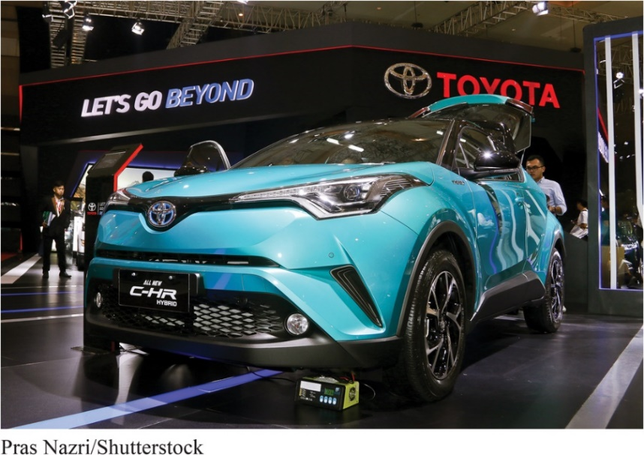
Supply Chains and Value Delivery Networks (3 of 3)
Value delivery network is composed of the company, suppliers, distributors, and, ultimately, customers who partner with each other to improve the performance of the entire system.
Value delivery network: In making and marketing its lines of cars, Toyota manages a huge network of people within the company plus thousands of outside suppliers, dealers, and marketing service firms that work together to deliver the brand’s “Let’s Go Places” and “Let’s Go Beyond” promises.
Notes:
A demand chain view of a business may be too limited because it takes a step-by-step, linear view of purchase-production-consumption activities. Instead, most large companies today are engaged in building and managing a complex, continuously evolving value delivery network.

Slide 8
The Nature and Importance of Marketing Channels (1 of 7)
Marketing channel (distribution channel) is a set of interdependent organizations that help make a product or service available for use or consumption by the consumer or business user.
Notes:
Few producers sell their goods directly to final users. Instead, most use intermediaries to bring their products to market. They try to forge a marketing channel (or distribution channel)—a set of interdependent organizations that help make a product or service available for use or consumption by the consumer or business user.
A company’s channel decisions directly affect every other marketing decision. Pricing depends on whether the company works with national discount chains, uses high-quality specialty stores, or sells directly to consumers online. Whether a company develops or acquires certain new products may depend on how well those products fit the capabilities of its channel members.
Many companies have used imaginative distribution systems to gain a competitive advantage. Examples include: Enterprise Rent-A-Car revolutionized the car-rental business, and Apple selling music for the iPod via the internet on iTunes and Amazon.com forever changed the face of retailing and became the Walmart of the internet.
Distribution channel decisions often involve long-term commitments to other firms. Therefore, management must design its channels carefully, with an eye on both today’s likely selling environment and tomorrow’s as well.

Slide 9
The Nature and Importance of Marketing Channels (2 of 7)
How Channel Members Add Value
Transform the assortment of products into assortments wanted by consumers.
Bridge the major time, place, and possession gaps that separate goods and services from users.
Notes:
Why do producers give some of the selling job to channel partners? After all, doing so means giving up some control over how and to whom they sell their products.
Producers use intermediaries because they create greater efficiency in making goods available to target markets. Through their contacts, experience, specialization, and scale of operation, intermediaries usually offer the firm more than it can achieve on its own.

Slide 10
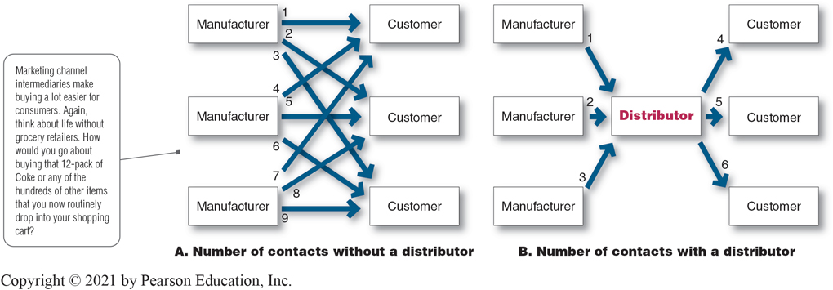
The Nature and Importance of Marketing Channels (3 of 7)
Figure 12.1 How a Distributor Reduces the Number of Channel Transactions
Notes:
Figure 12.1 shows how using intermediaries can provide economies. Figure 12.1A shows three manufacturers, each using direct marketing to reach three customers. This system requires nine different contacts. Figure 12.1B shows the three manufacturers working through one distributor, which contacts the three customers. This system requires only six contacts. In this way, intermediaries reduce the amount of work that must be done by both producers and consumers.
From the economic system’s point of view, the role of marketing intermediaries is to transform the assortments of products made by producers into the assortments wanted by consumers. Producers make narrow assortments of products in large quantities, but consumers want broad assortments of products in small quantities. Marketing channel members buy large quantities from many producers and break them down into the smaller quantities and broader assortments desired by consumers.
Long Description
The figure shows the following information:
Marketing channel intermediaries make buying a lot easier for consumers. Again, think about life without grocery retailers. How would you go about buying that 12-pack of Coke or any of the hundreds of other items that you now routinely drop into your shopping cart?
Number of contacts without a distributor
There are three manufacturers and three customers. Three arrows from each manufacturer point to the three customers.
Number of contacts with a distributor
There are three manufacturers and three customers. A single arrow from each manufacturer point to a distributor and three arrows from distributor point to the three customers (one arrow for each customer).

Slide 11
The Nature and Importance of Marketing Channels (4 of 7)
How Channel Members Add Value
Information
Promotion
Contact
Matching
Negotiation
Physical distribution
Financing
Risk taking
Notes:
In making products and services available to consumers, channel members add value by bridging the major time, place, and possession gaps that separate goods and services from those who use them. Members of the marketing channel perform many key functions.
Information: Gathering and distributing marketing research and intelligence information about actors and forces in the marketing environment needed for planning and aiding exchange.
Promotion: Developing and spreading persuasive communications about an offer.
Contact: Finding and communicating with prospective buyers.
Matching: Shaping and fitting the offer to the buyer’s needs, including activities such as manufacturing, grading, assembling, and packaging.
Negotiation: Reaching an agreement on price and other terms of the offer so that ownership or possession can be transferred.
Physical distribution: Transporting and storing goods.
Financing: Acquiring and using funds to cover the costs of the channel work.
Risk taking: Assuming the risks of carrying out the channel work.
The question is not whether these functions need to be performed—they must be—but rather who will perform them. To the extent that the manufacturer performs these functions, its costs go up; therefore, its prices must be higher. When some of these functions are shifted to intermediaries, the producer’s costs and prices may be lower, but the intermediaries must charge more to cover the costs of their work. In dividing the work of the channel, the various functions should be assigned to the channel members who can add the most value for the cost.

Slide 12
The Nature and Importance of Marketing Channels (5 of 7)
Number of Channel Levels
Channel level is a layer of intermediaries that performs some work in bringing the product and its ownership closer to the final buyer.
Direct marketing channel is a marketing channel that has no intermediary levels.
Indirect marketing channel is a marketing channel containing one or more intermediary levels.
Notes:
The definitions of each term here can be explained in conjunction with the illustration in Figure 12.2, Consumer and Business Marketing Channels, which is shown on the next slide.

Slide 13
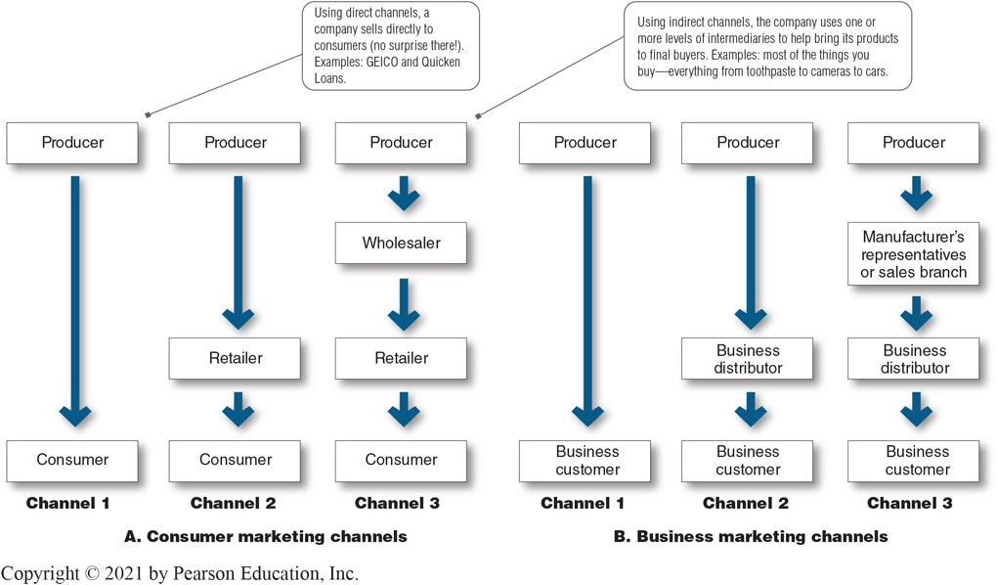
The Nature and Importance of Marketing Channels (6 of 7)
Figure 12.2 Consumer and Business Marketing Channels
Notes:
Companies can design their distribution channels to make products and services available to customers in different ways. Each layer of marketing intermediaries that performs some work in bringing the product and its ownership closer to the final buyer is a channel level. Because both the producer and the final consumer perform some work, they are part of every channel.
The number of intermediary levels indicates the length of a channel. Figure 12.2 shows both consumer and business channels of different lengths. Figure 12.2A shows several common consumer distribution channels. Channel 1, called a direct marketing channel, has no intermediary levels. The remaining channels in Figure 12.2A are indirect marketing channels, containing one or more intermediaries.
Figure 12.2B shows some common business distribution channels. The business marketer can use its own sales force to sell directly to business customers. Or it can sell to various types of intermediaries, who in turn sell to these customers.
Although consumer and business marketing channels with even more levels can sometimes be found, these are less common. From the producer’s point of view, a greater number of levels means less control and greater channel complexity.
Long Description
The figure shows the following information:
Consumer marketing channels
Channel 1: Arrow points from Producer to Consumer. Using direct channels, a company sells directly to consumers (no surprise there!). Examples: GEICO and Quicken Loans.
Channel 2: Arrows point from Producer to Retailer to Consumer.
Channel 3: Arrows point from Producer to Wholesaler to Retailer to Consumer. Using indirect channels, the company uses one or more levels of intermediaries to help bring its products to final buyers. Examples: most of the things you buy—everything from toothpaste to cameras to cars.
Business marketing channels
Channel 1: Arrow points from Producer to Business Customer.
Channel 2: Arrows point from Producer to Business distributor to Business customer.
Channel 3: Arrows point from Producer to Manufacturer’s representatives or sales branch to Business distributor to Business customer.

Slide 14
The Nature and Importance of Marketing Channels (7 of 7)
Number of Channel Levels
Channel members are connected by several types of flows:
Physical flow of products
Flow of ownership
Payment flow
Information flow
Promotion flow
Notes:
All the institutions in the channel are connected by several types of flows. These flows can make even channels with only one or a few levels very complex.

Slide 15
Learning Objective 2
Discuss how channel members interact and how they organize to perform the work of the channel.
Notes:
Discussion Question
Explain how a vertical marketing system differs from a conventional distribution channel.
Learning Objective 2 Summary
The channel will be most effective when each member assumes the tasks it can do best. Ideally, because the success of individual channel members depends on overall channel success, all channel firms should work together smoothly. They should understand and accept their roles, coordinate their goals and activities, and cooperate to attain overall channel goals. By cooperating, they can more effectively sense, serve, and satisfy the target market.
In a large company, the formal organization structure assigns roles and provides needed leadership. But in a distribution channel composed of independent firms, leadership and power are not formally set. Traditionally, distribution channels have lacked the leadership needed to assign roles and manage conflict. In recent years, however, new types of channel organizations have appeared that provide stronger leadership and improved performance.

Slide 16
Channel Behavior and Organization (1 of 13)
Channel Behavior
Marketing channels consist of firms that have partnered for their common good with each member playing a specialized role.
Notes:
Distribution channels are more than simple collections of firms tied together by various flows. They are complex behavioral systems in which people and companies interact to accomplish individual, company, and channel goals. Some channel systems consist of only informal interactions among loosely organized firms. Others consist of formal interactions guided by strong organizational structures. Moreover, channel systems do not stand still—new types of intermediaries emerge and whole new channel systems evolve. Here, we look at channel behavior and how members organize to do the work of the channel.
Ideally, because the success of individual channel members depends on the overall channel’s success, all channel firms should work together smoothly. They should understand and accept their roles, coordinate their activities, and cooperate to attain overall channel goals. However, individual channel members rarely take such a broad view. Cooperating to achieve overall channel goals sometimes means giving up individual company goals. Although channel members depend on one another, they often act alone in their own short-run best interests. They often disagree on who should do what and for what rewards. Such disagreements over goals, roles, and rewards generate channel conflict as discussed on the next slide.
Horizontal conflict occurs among firms at the same level of the channel. For instance, some firms may complain others steal sales from them by pricing too low or advertising outside their assigned territories. Other complaints may involve overcharging or giving poor service, hurting the overall image of the channel members.
Vertical conflict, conflict between different levels of the same channel, is even more common. For example, McDonald’s has recently faced growing conflict with its corps of almost 3,000 independent franchisees. In a recent company Webcast, based on rising customer complaints that service isn’t fast or friendly enough, McDonald’s told its franchisees that their cashiers need to smile more. At the same time, it seems, the franchisees weren’t very happy with McDonald’s either. Much of the conflict stems from a recent slowdown in systemwide sales that has both sides on edge. The most basic conflicts are financial. McDonald’s makes its money from franchisee royalties based on total system sales. In contrast, franchisees make money on margins—what’s left over after their costs.

Slide 17
Channel Behavior and Organization (2 of 13)
Channel Behavior
Channel conflict refers to disagreement among channel members over goals, roles, and rewards.
Horizontal conflict
Vertical conflict
Notes:
Horizontal conflict occurs among firms at the same level of the channel. For instance, some firms may complain others steal sales from them by pricing too low or advertising outside their assigned territories. Other complaints may involve overcharging or giving poor service, hurting the overall image of the channel members.
Vertical conflict, conflict between different levels of the same channel, is even more common. For example, McDonald’s has recently faced growing conflict with its corps of almost 3,000 independent franchisees. In a recent company Webcast, based on rising customer complaints that service isn’t fast or friendly enough, McDonald’s told its franchisees that their cashiers need to smile more. At the same time, it seems, the franchisees weren’t very happy with McDonald’s, either because of a recent slowdown in systemwide sales that has both sides on edge.

Slide 18
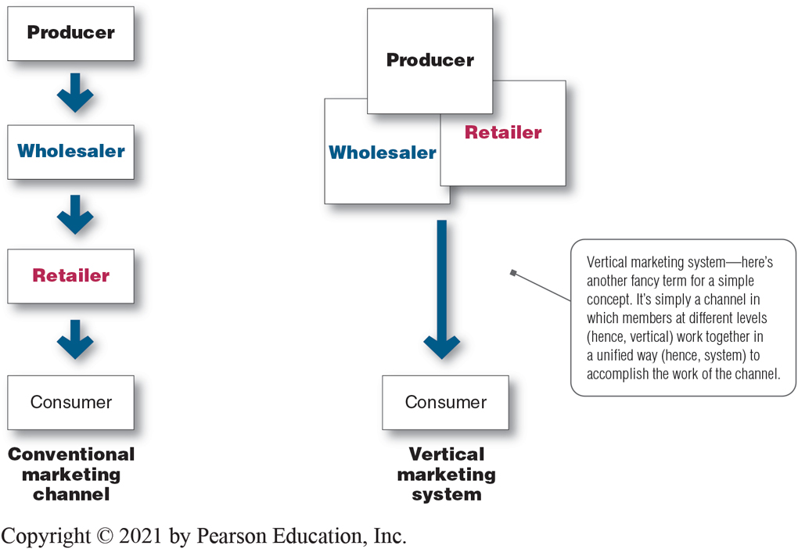
Channel Behavior and Organization (3 of 13)
Figure 12.3 Comparison of Conventional Distribution Channel with Vertical Marketing System
Notes:
A market is the set of actual and potential buyers of a product or service. Sellers must search for buyers, identify their needs, design good market offerings, set prices for them, promote them, and store and deliver them. Although marketing was traditionally carried out by sellers, the concept now also includes consumers. Consumers engage in marketing when they search for products, interact with companies to obtain information, and make their purchases. Thus, in addition to customer relationship management, companies must also deal with customer-managed relationships as customers are empowered and marketing is made a two-way affair. Figure 12.3 contrasts the two types of channel arrangements.
Long Description
The figure shows the following information:
Conventional marketing channel
Arrows point from Producer to Wholesaler to Retailer to Consumer.
Vertical marketing system
An arrow points from “Producer, Wholesaler, Retailer” to Consumer.
Vertical marketing system—here’s another fancy term for a simple concept. It’s simply a channel in which members at different levels (hence, vertical) work together in a unified way (hence, system) to accomplish the work of the channel.

Slide 19
Channel Behavior and Organization (4 of 13)
Vertical Marketing Systems
Conventional distribution systems consist of one or more independent producers, wholesalers, and retailers, each separate business seeking to maximize its own profits, perhaps even at the expense of profits for the system as a whole.
Notes:
Historically, conventional distribution channels have lacked leadership and power, often resulting in damaging conflict and poor performance. One of the biggest channel developments over the years has been the emergence of vertical marketing systems that provide channel leadership.

Slide 20
Channel Behavior and Organization (5 of 13)
Vertical Marketing Systems
Vertical marketing systems (V M Ss) provide channel leadership and consist of producers, wholesalers, and retailers acting as a unified system.
Corporate marketing systems
Contractual marketing systems
Administered marketing systems
Notes:
For the channel as a whole to perform well, each channel member’s role must be specified, and channel conflict must be managed. The channel will perform better if it includes a firm, agency, or mechanism that provides leadership and has the power to assign roles and manage conflict.
A vertical marketing system (VMS) consists of producers, wholesalers, and retailers acting as a unified system. One channel member owns the others, has contracts with them, or wields so much power that they must all cooperate. The VMS can be dominated by the producer, the wholesaler, or the retailer.

Slide 21
Channel Behavior and Organization (6 of 13)
Vertical Marketing Systems
Corporate vertical marketing systems combine successive stages of production and distribution under single ownership.
Notes:
A corporate VMS integrates successive stages of production and distribution under single ownership. Coordination and conflict management are attained through regular organizational channels.

Slide 22
Channel Behavior and Organization (7 of 13)
Vertical Marketing Systems
Contractual vertical marketing systems consist of independent firms at different levels of production and distribution who join together through contracts.
Notes:
A contractual VMS consists of independent firms at different levels of production and distribution who join together through contracts to obtain more economies or sales impact than each could achieve alone. Channel members coordinate their activities and manage conflict through contractual agreements.

Slide 23

Channel Behavior and Organization (8 of 13)
Vertical Marketing Systems
Franchise organization is a contractual vertical marketing system in which a channel member, called a franchisor, links several stages in the production-distribution process.
Franchising systems: Through franchising, Sports Clips—where you can “Get your hair in the game”—has rapidly grown to more than 1,700 locations.
Notes:
The franchise organization is the most common type of contractual relationship. In the United States alone, some 770,000 franchise outlets account for more than $830 billion of economic output. Industry analysts estimate that a new franchise outlet opens somewhere in the United States every eight minutes and that about one out of every 12 retail business outlets is a franchised business.
There are three types of franchises. The first type is the manufacturer-sponsored retailer franchise system—for example, Ford and its network of independent franchised dealers. The second type is the manufacturer-sponsored wholesaler franchise system—Coca-Cola licenses bottlers (wholesalers) in various world markets that buy Coca-Cola syrup concentrate, and then bottle and sell the finished product to retailers locally. The third type is the service-firm-sponsored retailer franchise system—for example, Burger King and its nearly 12,100 franchisee-operated restaurants around the world. Other examples can be found in everything from auto rentals, apparel retailers, and motels to supplemental education (Huntington Learning Center, Kumon) and personal services (Great Clips, Mr. Handyman, Anytime Fitness).
The fact that most consumers cannot tell the difference between contractual and corporate VMSs shows how successfully the contractual organizations compete with corporate chains.
The next chapter presents a fuller discussion of the various contractual VMSs.

Slide 24
Channel Behavior and Organization (9 of 13)
Vertical Marketing Systems
An administered vertical marketing system is a V M S that coordinates successive stages of production and distribution through the size and power of one of the parties.
Notes:
In an administered VMS, leadership is assumed not through common ownership or contractual ties but through the size and power of one or a few dominant channel members. Manufacturers of a top brand can obtain strong trade cooperation and support from resellers. For example, GE, P&G, and Apple can command unusual cooperation from many resellers regarding displays, shelf space, promotions, and price policies.
In turn, large retailers such as Walmart, Home Depot, Kroger, and Walgreens can exert strong influence on the many manufacturers that supply the products they sell. For example, in the normal push and pull between Walmart and its consumer goods suppliers, giant Walmart—the biggest grocer in the United States with a 25 percent share of all U.S. grocery sales—usually gets its way, so maintaining a strong relationship with the giant retailer is crucial.

Slide 25
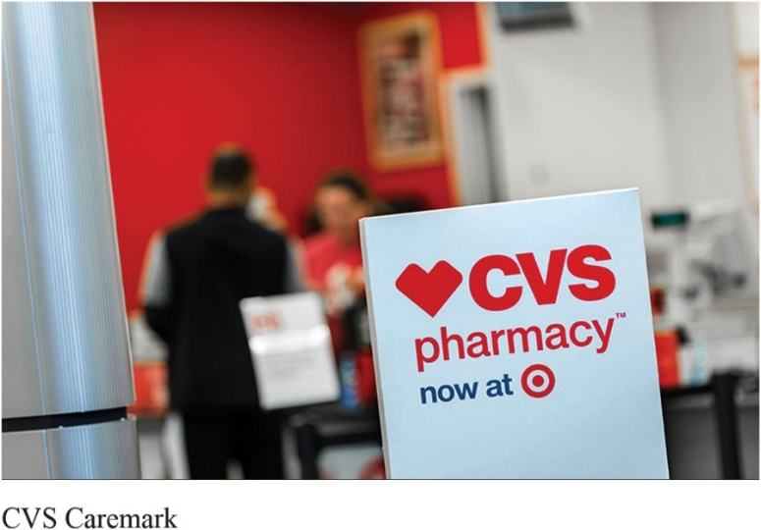
Channel Behavior and Organization (10 of 13)
Horizontal Marketing Systems
Horizontal marketing system is a channel arrangement in which two or more companies at one level join together to follow a new marketing opportunity.
Horizontal marketing systems: Target partners with CVS Health, who operates stores-within-stores to the benefit of all – Target, CVS, and their mutual customers.
Notes:
Discussion Question
Can you think of an example where two companies join for a horizontal marketing system?
Students might notice that McDonald’s is in Walmart or their gas station also has a coffee franchise.
By working together, companies can combine their financial, production, or marketing resources to accomplish more than any one company could alone. Companies might join forces with competitors or noncompetitors. They might work with each other on a temporary or permanent basis, or they may create a separate company. For example, competing big media companies Fox Broadcasting, Disney-ABC, and NBCUniversal (Comcast) jointly own and market Hulu, and together they compete more effectively against digital streaming competitors such as Netflix. Walmart partners with noncompetitor McDonald’s to place “express” versions of McDonald’s restaurants in Walmart stores. McDonald’s benefits from Walmart’s heavy store traffic, and Walmart keeps hungry shoppers from needing to go elsewhere to eat.
Such channel arrangements also work well globally. For example, competitors General Mills and Nestlé operate a joint venture—Cereal Partners Worldwide—to market General Mills BigG cereal brands in 130 countries outside North America. General Mills supplies a kitchen cabinet full of quality cereal brands, whereas Nestlé contributes its extensive international distribution channels and local market knowledge.

Slide 26
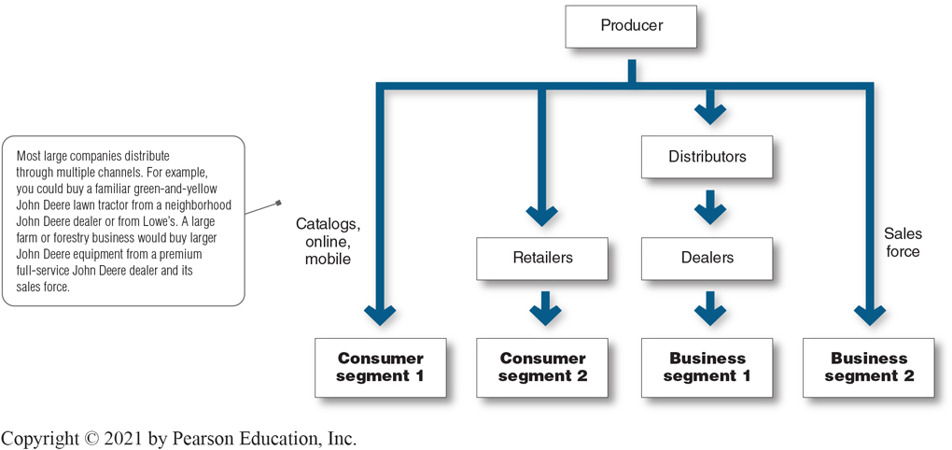
Channel Behavior and Organization (11 of 13)
Figure 12.4 Multichannel Distribution System
Notes:
Figure 12.4 shows a multichannel marketing system. In the figure, the producer sells directly to consumer segment 1 using catalogs, telemarketing, online, and mobile channels and reaches consumer segment 2 through retailers. It sells indirectly to business segment 1 through distributors and dealers and to business segment 2 through its own sales force.
Multichannel distribution systems offer many advantages to companies facing large and complex markets. With each new channel, the company expands its sales and market coverage and gains opportunities to tailor its products and services to the specific needs of diverse customer segments.
But such multichannel systems are harder to control, and they can generate conflict as more channels compete for customers and sales. For example, when John Deere first began selling selected consumer products through Lowe’s home improvement stores, many of its independent dealers complained loudly. To avoid such conflicts in its internet marketing channels, the company routes all of its online sales to John Deere dealers.
Long Description
The flowchart shows the following information:
Most large companies distribute through multiple channels. For example, you could buy a familiar green-and-yellow John Deere lawn tractor from a neighborhood John Deere dealer or from Lowe’s. A large farm or forestry business would buy larger John Deere equipment from a premium full-service John Deere dealer and its sales force.
Arrow points from Producer to “Consumer segment 1” via catalogs, online, mobile.
Arrows point from Producer to Retailers to “Consumer segment 2.”
Arrows point from Producer to Distributors to Dealers to “Business segment 1.”
Arrow points from Producer to “Business segment 2” via sales force.

Slide 27
Channel Behavior and Organization (12 of 13)
Multichannel Distribution Systems
Multichannel distribution systems are systems in which a single firm sets up two or more marketing channels to reach one or more customer segments.
Notes:
In the past, many companies used a single channel to sell to a single market or market segment. These days, almost every large company and many small ones distribute through multiple channels.
For example, John Deere sells its familiar green-and-yellow lawn and garden tractors, mowers, and outdoor power products to consumers and commercial users through several channels, including John Deere retailers, Lowe’s home improvement stores, and online. It sells and services its tractors, combines, planters, and other agricultural equipment through its premium John Deere dealer network. And it sells large construction and forestry equipment through selected large, full-service John Deere dealers and their sales forces.

Slide 28
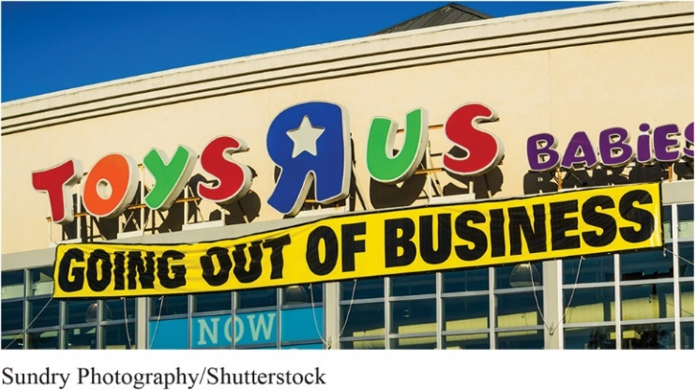
Channel Behavior and Organization (13 of 13)
Changing Channel Organization
Disintermediation is the cutting out of marketing channel intermediaries by producers or the displacement of traditional resellers by new intermediaries.
Disintermediation: Toys“R”Us pioneered the superstore format that once made it the go-to place for buying toys. But after falling victim to shifts in toy market sales to big discounters like Walmart and online merchants like Amazon, the retail giant was forced to close down operations and shutter its stores.
Notes:
Changes in technology and the explosive growth of direct and online marketing are having a profound impact on the nature and design of marketing channels. One major trend is toward disintermediation—a big term with a clear message and important consequences. Thus, in many industries, traditional intermediaries are dropping by the wayside, as is the case with online marketers taking business from traditional brick-and-mortar retailers.
For example, online music download services such as iTunes and Amazon MP3 have pretty much put traditional music-store retailers out of business. In turn, streaming music services such as Spotify and Vevo are now disintermediating digital download services. Similarly, Amazon.com almost single-handedly bankrupted the nation’s number-two bookseller, Borders, in less than 10 years. And the burgeoning online-only merchant has recently forced highly successful store retailers such as Best Buy to dramatically rethink their entire operating models. In fact, many retailing experts question whether stores like Best Buy can compete in the long run against online rivals.
Like resellers, to remain competitive, product and service producers must develop new channel opportunities, such as the internet and other direct channels. However, developing these new channels often brings them into direct competition with their established channels, resulting in conflict. To ease this problem, companies often look for ways to make going direct a plus for the entire channel. For example, Black & Decker knows that many customers would prefer to buy online but this would create conflicts with important and powerful retail partners, such as Home Depot, Walmart, Sears, and Amazon.com. So, although Black & Decker’s online site provides detailed information about the company’s products, you can’t buy a Black & Decker cordless drill, laser level, leaf blower, power garden shears, or anything else there. Instead, the Black & Decker site refers you to resellers’ sites and stores. Thus, Black & Decker’s direct marketing helps both the company and its channel partners.

Slide 29
Learning Objective 3
Identify the major channel alternatives open to a company.
Notes:
Discussion Question
Provide an example of a vertical, horizontal, or multichannel marketing system.
Learning Objective 3 Summary
Channel alternatives vary from direct selling to using one, two, three, or more intermediary channel levels. Marketing channels face continuous and sometimes dramatic change. Three of the most important trends are the growth of vertical, horizontal, and multichannel marketing systems. These trends affect channel cooperation, conflict, and competition. Channel design begins with assessing customer channel service needs and company channel objectives and constraints. The company then identifies the major channel alternatives in terms of the types of intermediaries, the number of intermediaries, and the channel responsibilities of each. Each channel alternative must be evaluated according to economic, control, and adaptive criteria. Channel management calls for selecting qualified intermediaries and motivating them. Individual channel members must be evaluated regularly.

Slide 30
Channel Design Decisions (1 of 8)
Marketing channel design
Designing effective marketing channels by analyzing customer needs, setting channel objectives, identifying major channel alternatives, and evaluating those alternatives.
Notes:
For maximum effectiveness, channel analysis and decision making should be purposeful. This requires marketing channel design.

Slide 31
Channel Design Decisions (2 of 8)
Analyzing consumer needs
Setting channel objectives
Identifying channel alternatives
Evaluating channel alternatives
Notes:
We now look at several channel design decisions manufacturers face. In designing marketing channels, manufacturers struggle between what is ideal and what is practical.
A new firm with limited capital usually starts by selling in a limited market area. In this case, the problem is not deciding on the best channels but how to convince one or a few good intermediaries to handle the line.
If successful, the new firm can branch out to new markets through existing intermediaries. In smaller markets, the firm might sell directly to retailers; in larger markets, it might sell through distributors. In one part of the country, it might grant exclusive franchises; in another, it might sell through all available outlets. Then it might add an internet store that sells directly to hard-to-reach customers. In this way, channel systems often evolve to meet market opportunities and conditions.

Slide 32
Channel Design Decisions (3 of 8)
Analyzing Consumer Needs
Find out what target consumers want from the channel
Identify market segments
Determine the best channels to use
Minimize the cost of meeting customer service requirements
Notes:
Usually, a company can identify several segments wanting different levels of service. The company should decide which segments to serve and the best channels to use in each case. In each segment, the company wants to minimize the total channel cost of meeting customer service requirements.
Providing the fastest delivery, the greatest assortment, and the most services may not be possible, practical, or desired. The company and its channel members may not have the resources or skills needed to provide all the desired services. Also, providing higher levels of service results in higher costs for the channel and higher prices for consumers. The success of modern discount retailing shows that consumers will often accept lower service levels in exchange for lower prices.

Slide 33
Channel Design Decisions (4 of 8)
Setting Channel Objectives
Determine targeted levels of customer service
Balance consumer needs against costs and customer price preferences
Notes:
The company’s channel objectives are influenced by the nature of the company, its products, its marketing intermediaries, its competitors, and the environment.
To determine targeted levels of customer service, companies must answer the following questions: Do consumers want to buy from nearby locations or are they willing to travel to more distant and centralized locations? Would customers rather buy in person, by phone, or online? Do they value breadth of assortment or do they prefer specialization? Do consumers want many add-on services (delivery, installation, repairs), or will they obtain these services elsewhere?
For example, the company’s size and financial situation determine which marketing functions it can handle itself and which it must give to intermediaries. In some cases, a company may want to compete in or near the same outlets that carry competitors’ products.
Finally, environmental factors such as economic conditions and legal constraints may affect channel objectives and design. For example, in a depressed economy, producers will want to distribute their goods in the most economical way, using shorter channels and dropping unneeded services that add to the final price of the goods. The objective is to prioritize consumer needs against costs and customer price preferences.

Slide 34
Channel Design Decisions (5 of 8)
Identifying Major Alternatives
Types of intermediaries refers to channel members available to carry out channel work. Most companies face many channel member choices.
Notes:
Types of intermediaries refers to channel members available to carry out channel work. Most companies face many channel member choices.

Slide 35
Channel Design Decisions (6 of 8)
Identifying Major Alternatives
Number of Marketing Intermediaries
Intensive distribution
Exclusive distribution
Selective distribution
Notes:
Number of Marketing Intermediaries
Companies must determine the number of channel members to use at each level. Three strategies are available:
Producers of convenience products and common raw materials typically seek intensive distribution—a strategy in which they stock their products in as many outlets as possible.
Some producers purposely limit the number of intermediaries through exclusive distribution, in which the producer gives only a limited number of dealers the exclusive right to distribute its products in their territories. Exclusive distribution is often found in the distribution of luxury brands.
Between intensive and exclusive distribution lies selective distribution—the use of more than one but fewer than all of the intermediaries who are willing to carry a company’s products. Most consumer electronics, furniture, and home appliance brands are distributed in this manner.

Slide 36
Channel Design Decisions (7 of 8)
Identifying Major Alternatives
Responsibilities of Channel Members
A producer and the intermediaries need to agree on
Price policies
Conditions of sale
Territory rights
Specific services
Notes:
In addition, the producer should establish a list price and a fair set of discounts for the intermediaries. It must define each channel member’s territory, and it should be careful about where it places new resellers.
Mutual services and duties need to be spelled out carefully, especially in franchise and exclusive distribution channels.

Slide 37
Channel Design Decisions (8 of 8)
Evaluating Major Alternatives
Economic criteria
Control issues
Adaptability criteria
Notes:
Using economic criteria, a company compares the likely sales, costs, and profitability of different channel alternatives. What will be the investment required by each channel alternative, and what returns will result?
The company must also consider control issues. Using intermediaries usually means giving them some control over the marketing of the product, and some intermediaries take more control than others. Other things being equal, the company prefers to keep as much control as possible.
Finally, the company must apply adaptability criteria. Channels often involve long-term commitments, yet the company wants to keep the channel flexible so that it can adapt to environmental changes. Thus, to be considered, a channel involving long-term commitments should be greatly superior on economic and control grounds.

Slide 38
Learning Objective 4
Explain how companies select, motivate, and evaluate channel members.
Notes:
Discussion Question
What types of exclusive arrangements do manufacturers develop with resellers? Are these arrangements legal?
Learning Objective 4 Summary
Producers vary in their ability to attract qualified marketing intermediaries. Some producers have no trouble signing up channel members, whereas others have to work hard to line up enough qualified intermediaries. When selecting intermediaries, the company should evaluate each channel member’s qualifications and select those that best fit its channel objectives.
Once selected, channel members must be continuously motivated to do their best. The company must sell not only through the intermediaries but also with them. It should forge strong partnerships with channel members to create a marketing system that meets the needs of both the manufacturer and the partners.

Slide 39
Channel Management Decision
Selecting channel members
Managing channel members
Motivating channel members
Evaluating channel members
Notes:
Once the company has reviewed its channel alternatives and determined the best channel design, it must implement and manage the chosen channel. Marketing channel management calls for selecting, managing, and motivating individual channel members and evaluating their performance over time.
Discussion Question
If you were a manufacturer, how would you select channel members?
Most likely students will look at years in business, profitability, and other products served.
Selecting Channel Members
Producers vary in their ability to attract qualified marketing intermediaries. Some producers have no trouble signing up channel members and others have to work hard to line up enough qualified intermediaries.
For example, when Timex first tried to sell its inexpensive watches through regular jewelry stores, most jewelry stores refused to carry them. The company then managed to get its watches into mass-merchandise outlets.
Even established brands may have difficulty gaining and keeping their desired distribution, especially when dealing with powerful resellers. For example, you won’t find P&G’s Pampers diapers in a Costco store. After P&G declined to manufacture Costco’s Kirkland store brand diapers a few years ago, Costco gave Pampers the boot.
When selecting intermediaries, the company should determine what characteristics distinguish the better ones. It will want to evaluate each channel member’s years in business, other lines carried, location, growth and profit record, cooperativeness, and reputation.
Discussion Question
How do you motivate and evaluate channel members?
Some students might have worked in stores where the salespeople were given rewards for excellent sales or service.
Managing and Motivating Channel Members
Once selected, channel members must be continuously managed and motivated to do their best. The company must sell not only through the intermediaries but also to and with them. In managing channel members, companies practice partner relationship management (PRM) and supply chain management (SCM) to develop long-term relationships.
Evaluating Channel Members
The company must regularly check channel member performance against standards such as sales quotas, average inventory levels, customer delivery time, treatment of damaged and lost goods, cooperation in company promotion and training programs, and services to the customer. The company should recognize and reward intermediaries who are performing well, assist those performing poorly or, as a last resort, replace them.
Finally, companies need to be sensitive to the needs of their channel partners. Those who treat their partners poorly risk not only losing their support but also causing some legal problems. The next section describes various rights and duties pertaining to companies and other channel members.

Slide 40
Public Policy and Distribution Decisions
Exclusive distribution is when the producer gives only a limited number of dealers the exclusive right to distribute its products in their territories.
Exclusive dealing is when the seller requires that the exclusive distribution sellers not handle competitor’s products.
Exclusive territorial agreements are where producer or seller limit territory.
Tying agreements are agreements where the dealer must take most or all of the line.
Notes:
For the most part, companies are legally free to develop whatever channel arrangements suit them. In fact, the laws affecting channels seek to prevent the exclusionary tactics of some companies that might keep another company from using a desired channel. Most channel law deals with the mutual rights and duties of channel members once they have formed a relationship.
Producers are free to select their dealers, but their right to terminate dealers is somewhat restricted. In general, sellers can drop dealers “for cause.” However, they cannot drop dealers if, for example, the dealers refuse to cooperate in a doubtful legal arrangement, such as exclusive dealing or tying agreements.

Slide 41
Learning Objective 5
Discuss the nature and importance of marketing logistics and integrated supply chain management.
Notes:
Discussion Question
What are third-party logistics providers and why do companies use them?
Learning Objective 5 Summary
Marketing logistics (or physical distribution) is an area of potentially high cost savings and improved customer satisfaction. Marketing logistics addresses not only outbound logistics but also inbound logistics and reverse logistics. That is, it involves the entire supply chain management—managing value-added flows between suppliers, the company, resellers, and final users. No logistics system can both maximize customer service and minimize distribution costs. Instead, the goal of logistics management is to provide a targeted level of service at the least cost. The major logistics functions are warehousing, inventory management, transportation, and logistics information management.
The integrated supply chain management concept recognizes that improved logistics requires teamwork in the form of close working relationships across functional areas inside the company and across various organizations in the supply chain. Companies can achieve logistics harmony among functions by creating cross-functional logistics teams, integrative supply manager positions, and senior-level logistics executive positions with cross-functional authority. Channel partnerships can take the form of cross-company teams, shared projects, and information sharing systems. Today, some companies are outsourcing their logistics functions to third-party logistics (3PL) providers to save costs, increase efficiency, and gain faster and more effective access to global markets.

Slide 42
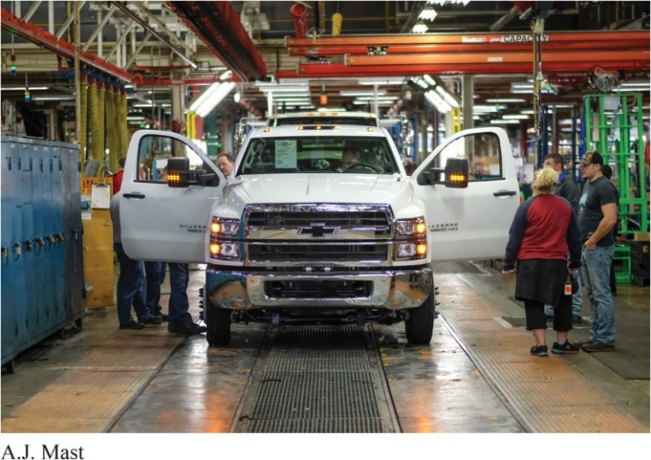
Marketing Logistics and Supply Chain Management (1 of 5)
Nature and Importance of Marketing Logistics
Marketing logistics (physical distribution) involves planning, implementing, and controlling the physical flow of goods, services, and related information from points of origin to points of consumption to meet consumer requirements at a profit.
The importance or logistics: At any given time, GM has hundreds of millions of tons of finished vehicles and parts in transit, running up an annual logistics bill of about $8 billion. Even small savings can be substantial.
Notes:
In today’s global marketplace, selling a product is sometimes easier than getting it to customers. Companies must decide on the best way to store, handle, and move their products and services so that they are available to customers in the right assortments, at the right time, and in the right place.
Logistics effectiveness has a major impact on both customer satisfaction and company costs. Here we consider the nature and importance of logistics management in the supply chain, the goals of the logistics system, major logistics functions, and the need for integrated supply chain management.

Slide 43
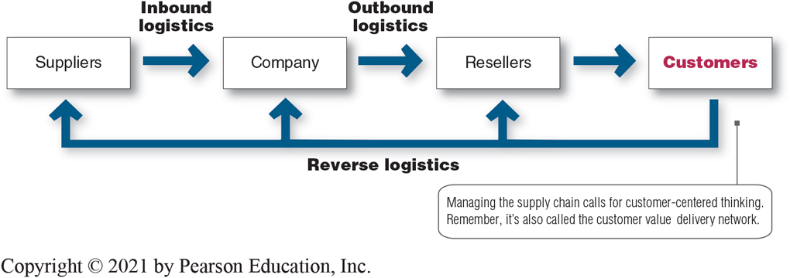
Marketing Logistics and Supply Chain Management (2 of 5)
Figure 12.5 Supply Chain Management
Notes:
To some managers, marketing logistics means only trucks and warehouses. But modern logistics is much more than this. Marketing logistics—also called physical distribution— involves planning, implementing, and controlling the physical flow of goods, services, and related information from points of origin to points of consumption to meet customer requirements at a profit. In short, it involves getting the right product to the right customer in the right place at the right time.
In the past, physical distribution planners typically started with products at the plant and then tried to find low-cost solutions to get them to customers. However, today’s customer-centered logistics starts with the marketplace and works backward to the factory or even to sources of supply.
Marketing logistics involves not only outbound logistics (moving products from the factory to resellers and ultimately to customers) but also inbound logistics (moving products and materials from suppliers to the factory) and reverse logistics (reusing, recycling, refurbishing, or disposing of broken, unwanted, or excess products returned by consumers or resellers).
Long Description
The flowchart shows the following information:
An arrow labeled “Inbound logistics” points from Suppliers to Company
An arrow labeled “Outbound logistics” points from Company to Resellers
An arrow points from Resellers to Customers
Arrows labeled “Reverse logistics” point back from Customers to resellers, company, and suppliers.
Managing the supply chain calls for customer-centered thinking. Remember, it’s also called the customer value delivery network.

Slide 44
Marketing Logistics and Supply Chain Management (3 of 5)
Nature and Importance of Marketing Logistics
Supply chain management involves managing upstream and downstream value-added flows of materials, final goods, and related information among suppliers, the company, resellers, and final consumers.
Goal of marketing logistics should be to provide a targeted level of customer service at the least cost.
Notes:
Marketing logistics involves entire supply chain management—managing upstream and downstream value-added flows of materials, final goods, and related information among suppliers, the company, resellers, and final consumers, as shown in Figure 12.5 in the previous slide.
Some companies state their logistics objective as providing maximum customer service at the least cost. Unfortunately, as nice as this sounds, no logistics system can both maximize customer service and minimize distribution costs.
The goal of marketing logistics should be to provide a targeted level of customer service at the least cost. A company must first research the importance of various distribution services to customers and then set desired service levels for each segment.
The objective is to maximize profits, not sales. Therefore, the company must weigh the benefits of providing higher levels of service against the costs. Some companies offer less service than their competitors and charge a lower price. Other companies offer more service and charge higher prices to cover higher costs.

Slide 45
Marketing Logistics and Supply Chain Management (4 of 5)
Major Logistics Functions
Warehousing
Inventory management
Transportation
Logistics information management
Notes:
Discussion Question
What is the importance of logistics?
Student responses should include:
Competitive advantage by giving customers better service at lower prices.
Cost savings to the company and its customers.
Product variety requires improved logistics.
Information technology has created opportunities for distribution efficiency.
Major Logistics Functions
Warehousing
Production and consumption cycles rarely match, so most companies must store their goods while they wait to be sold. A company must decide on how many and what types of warehouses it needs and where they will be located. The company might use either storage warehouses or distribution centers. Storage warehouses store goods for moderate to long periods. In contrast, distribution centers are designed to move goods rather than just store them.
Inventory Management
Inventory management also affects customer satisfaction. Managers must balance the costs of carrying larger inventories against resulting sales and profits. Many companies have greatly reduced their inventories and related costs through just-in-time logistics systems which result in substantial savings in inventory-carrying and inventory-handling costs. Companies using RFID know, at any time, exactly where a product is located physically within the supply chain. “Smart shelves” not only tell them when it’s time to reorder but also place the order automatically with suppliers.
Transportation
The choice of transportation carriers affects the pricing of products, delivery performance, and the condition of goods when they arrive—all of which will affect customer satisfaction. In shipping goods to its warehouses, dealers, and customers, the company can choose among five main transportation modes: truck, rail, water, pipeline, and air, along with an alternative mode for digital products—the internet. Multimodal transportation involves combining two or more modes of transportation.
Logistics Information Management
Companies manage their supply chains through information. Channel partners often link up to share information and make better joint logistics decisions. From a logistics perspective, flows of information, such as customer transactions, billing, shipment and inventory levels, and even customer data, are closely linked to channel performance. Companies need simple, accessible, fast, and accurate processes for capturing, processing, and sharing channel information. Information can be shared and managed in many ways, but most sharing takes place through electronic data interchange (EDI), the digital exchange of data between organizations, which is transmitted primarily via the internet. Walmart, for example, requires EDI links with its more than 100,000 suppliers through its Retail Link sales data system.

Slide 46
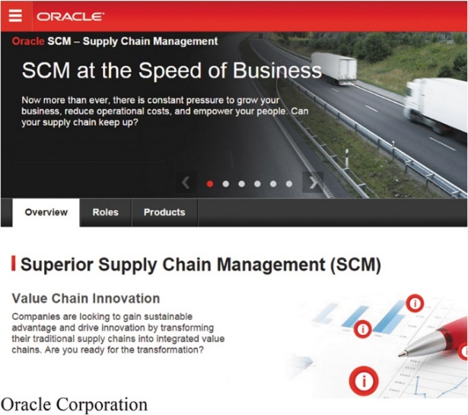
Marketing Logistics and Supply Chain Management (5 of 5)
Integrated Logistics Management
Integrated logistics management is the recognition that providing customer service and trimming distribution costs requires teamwork internally and externally.
Integrated logistics management: Oracle’s supply chain management software solutions help companies to “gain sustainable advantage and drive innovation by transforming their traditional supply chains into integrated value chains.”
Notes:
Integrated logistics management: Oracle’s supply chain management software solutions help companies to “gain sustainable advantage and drive innovation by transforming their traditional supply chains into integrated value chains.”
Integrated Logistics Management
Today, more and more companies are adopting the concept of integrated logistics management. Inside, the company’s various departments must work closely together to maximize its own logistics performance. Outside, the company must integrate its logistics system with those of its suppliers and customers to maximize the performance of the entire distribution network.
Cross-Functional Teamwork Inside the Company
Most companies assign responsibility for various logistics activities to many different departments—marketing, sales, finance, operations, and purchasing. Too often, each function tries to optimize its own logistics performance without regard for the activities of the other functions. Because distribution activities involve strong trade-offs, decisions by different functions must be coordinated to achieve better overall logistics performance.
Building Logistics Partnerships
Companies must do more than improve their own logistics. They must also work with other channel partners to improve whole-channel distribution. The members of a marketing channel are linked closely in creating customer value and building customer relationships. One company’s distribution system is another company’s supply system. The success of each channel member depends on the performance of the entire supply chain. Smart companies coordinate their logistics strategies and forge strong partnerships with suppliers and customers to improve customer service and reduce channel costs. Many companies have created cross-functional and cross-company teams. Other companies partner through shared projects. The point is that all supply chain members must work together in the cause of bringing value to final consumers.
Third-Party Logistics
Although most big companies love to make and sell their products, many loathe the associated logistics “grunt work.” A growing number of firms now outsource some or all of their logistics to third-party logistics (3PL) providers such as Ryder, Penske Logistics, BAX Global, DHL Logistics, FedEx Logistics, and UPS Business Solutions. Outsourced logistics providers can help companies improve their own logistics systems or even take over and manage part or all of their logistics operations.

Slide 47

Copyright
This work is protected by United States copyright laws and is provided solely for the use of instructors in teaching their courses and assessing student learning. Dissemination or sale of any part of this work (including on the World Wide Web) will destroy the integrity of the work and is not permitted. The work and materials from it should never be made available to students except by instructors using the accompanying text in their classes. All recipients of this work are expected to abide by these restrictions and to honor the intended pedagogical purposes and the needs of other instructors who rely on these materials.

